Slide 1
ACC Spring Semester
Courses
College Prep
Mr. Gordon
jgordon@bisdtx.org

Slide 2
Upcoming Events
Fri. Nov. 12th 9th and 10th Texas A&M University Tour. Please check the library window for more information
Fri. Nov. 19th Picture Day
Sat. Dec. 4th Winter Dance All Grades are Invited
hi

Slide 3

ACC Spring Classes
Before we continue on our Virtual College Tours, your ACC Spring Semester classes have been added.
Follow the instructions on the following slides to verify that you are registered for the correct classes.
hi

Slide 4
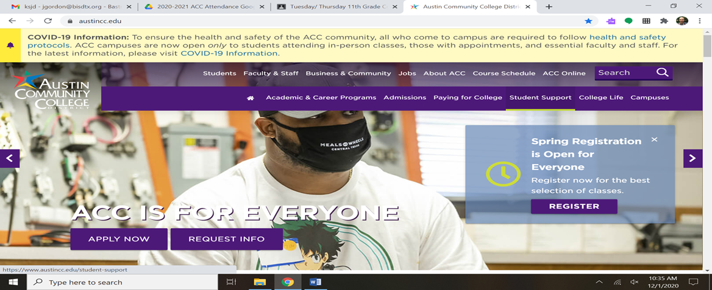
ACC Spring Classes
Step 1: Go to austincc.edu and click “Students” at the top.
hi

Slide 5
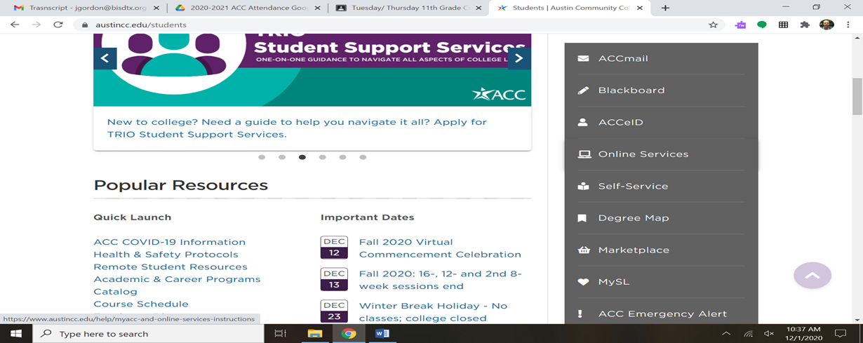
ACC Spring Classes
Step 2: Scroll down and click “Self-Service” in the middle right.
hi

Slide 6
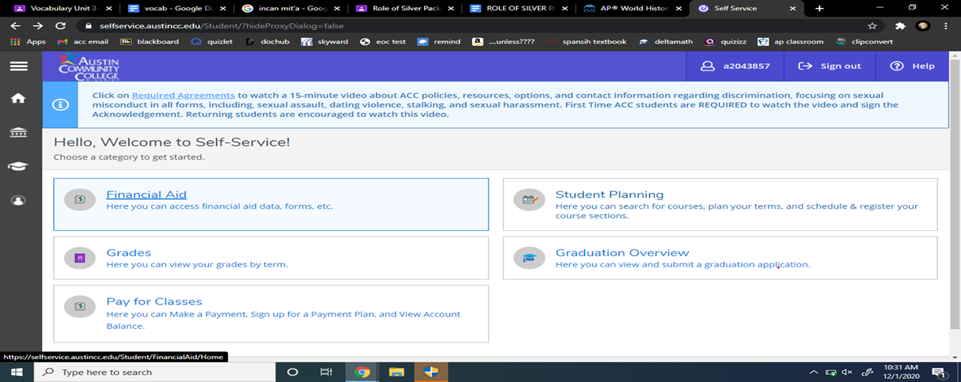
ACC Spring Classes
Step 3: Login to MyACC and click on “Student Planning”
hi

Slide 7
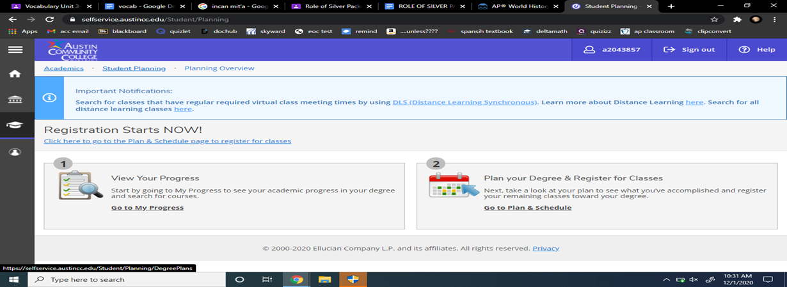
ACC Spring Classes
Step 4: Click on “Go to Plan & Schedule” under Plan your Degree & Register for Classes
hi

Slide 8
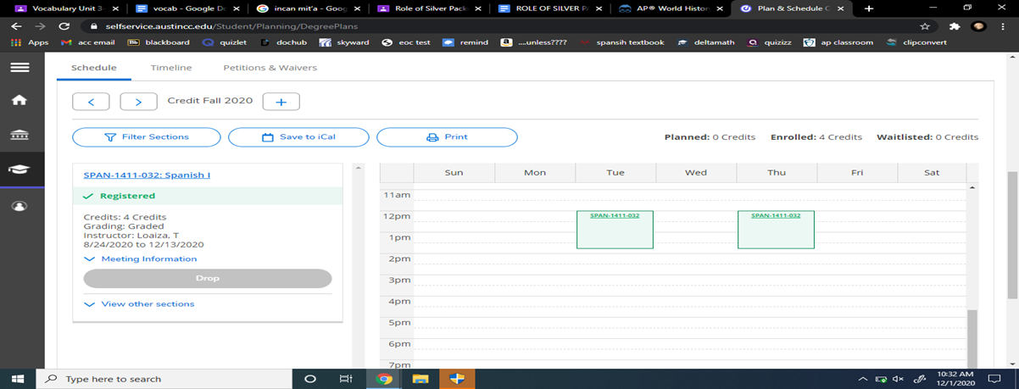
ACC Spring Classes
Step 5: Scroll down and you will see the schedule. You will need to click the right arrow to change it from Fall 2021 to Spring 2022.
hi

Slide 9
ACC Spring Classes
Step 6: Verify that you are registered for SPAN- 1412- Spanish 2
and SPCH 1315- Public Speaking.
You will be able to see your class times and professors.
This is only if you pass Spanish 1.
You cannot take Spanish 2 if you do not pass Spanish 1.
hi

Slide 10
Today’s College Prep Assignment
In the comments section of today’s College Prep,
answer the following question:
Are you in the correct classes? Yes or No.
If not, please contact Mr. Gordon or Mr. Longoria ASAP.
hi

